Slide 1



Kesler Science Teacher Resource
Differentiated Learning:
Listed below are the three different modification levels used for this lab. Each lab is differentiated using the icons below. They are also included in labeled sections on the preview to the left.
Independent Inquiry: This level is the most student-centered experience. Suggestions are made for the students to get started, but most of the decisions will be student-centered. The students will be responsible for most aspects of the lab and will have the least guidance. Suggested for advanced learners.
Dependent Inquiry: This level is written with a combination of procedural instructions and inquiry questions. They are moderately student-centered with guided inquiry questions throughout the lab. Suggested for on-level learners.
Modified Inquiry: This level provides the most structured lab experience. The lessons may eliminate parts of the lab and change the questioning to include sentence stems or multiple choice questions. Suggested for learners with modifications.
CER:
Students will be using the CER model at the conclusion of the lab. The CER model includes 3 parts.
Claim – A statement that answers the original question. Usually one sentence in length. Must be specific and answer the question.
Evidence – Scientific data that supports the claim. It may include numbers but can also state observations.
Reasoning – Explanation that connects evidence to the claim. Answers “why” the evidence supports the claim. Includes science concepts by name (ex. thermal energy, chemical reaction).
YouTube Video on the CER Model. (CER - Claim Evidence Reasoning – Bozeman Science)
https://www.youtube.com/watch?v=5KKsLuRPsvU&t=346s

Slide 2


Heredity Lab Teacher Directions
General:
- partners or small groups
- one, 45-minute class period
Standards:
TEKS: 7.14.A Define heredity as the passage of genetic instructions from one generation to the next generation.
Teacher Notes:
In this lab, students will study their personal traits then chart the traits of the entire group. They will compare to other groups in the classroom to look for patterns and explain what may have caused the pattern. You can provide guidance or allow them to look up different traits.
Some example inherited traits are: Earlobe attachment, dimples, handedness, curly hair, hand-clasping
Some example acquired traits are: knowledge about a topic, scars, muscle tone, ability to speak multiple languages, piercings.
Materials per Group:
Pencil
Paper
Mirror
Additional Resources For This Topic:
Genetics Complete 5E Lesson – Includes engagement activity, word wall cards, objective cards, student-led station lab, interactive notebook templates, PowerPoint, modified notes, student-choice project, homework, and assessment (including modified)
https://www.teacherspayteachers.com/Product/Genetics-Complete-5E-Lesson-Plan-3133795
Genetics Station Lab – Includes 8 stations where students will receive new information at the input stations (Read, Watch, Explore, Research) and demonstrate understanding at the output stations (Write, Organize, Assess, Illustrate). https://www.teacherspayteachers.com/Product/Genetics-Student-Led-Station-Lab-3132957

Slide 3
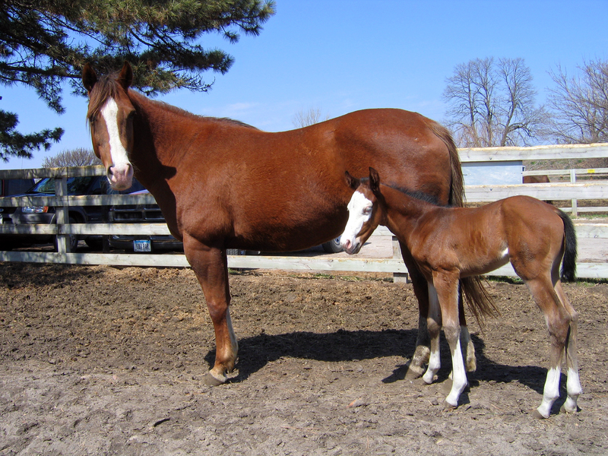
Heredity Student Lab Sheet
Essential Question:
How does heredity influence traits?
Background:
Heredity is the passing of traits to offspring from parents. Genetic material from the parents provides the instructions for the offspring’s form and development. Heredity is responsible for inherited traits such as hair color, eye color, etc.
In contrast, acquired traits are the effects of the environment of an organism. For example, a horse’s muscle size is determined by their nutrition and activity
level, not its parents’ genetics.
The sequences of DNA that cause inherited traits are called the genotype. The phenotype is all the observable traits of an organism: those caused by its genetic makeup (genotype) plus the acquired traits from the environment. The environment of an area may cause the same acquired traits to appear in organisms with different genotypes.
In this lab, you will study your personal traits then chart the traits of the entire group. You will compare traits with the class to patterns and explain where the patterns might have come from.
Materials per Group:
Pencil
Paper
Mirror
Procedure:
As a group, make a list of inherited traits that can be easily observed.
Inherited Traits

Slide 4
Heredity Student Lab Sheet
With the mirror, examine your personal traits and record them on the chart below.
Decide if each trait is inherited or acquired and check the correct column.
Put a star next to each trait that is due to your genotype.
Put a check mark next to each trait that is part of your phenotype.
Individual Traits Group Results
Trait | Inherited | Acquired |  | Male | Female

Slide 5
Heredity Student Lab Sheet
Now check within your group and record how many males and females have each of your traits.
After the small group is finished comparing traits, chart all the class traits on the class board.
Discuss the patterns seen and answer the follow questions:
What is the most common trait in your class?
Is this an inherited trait or acquired trait? Explain why.
What is the least common trait?
Why do you think it is not common?
Check for Understanding
How are inherited traits handed down from one generation to the next?

Slide 6
Heredity Student Lab Sheet
Conclusion: How does heredity affect an organism’s traits?
Claim:
Evidence:
Reasoning:
Reflections:
What is the difference between inherited and acquired traits?
How does each generation pass traits to offspring?
What is the difference between the genotype and phenotype of an organism?

Slide 7
Heredity Teacher Answer Key
Essential Question:
How does heredity influence traits?
Background:
Heredity is the passing of traits to offspring from parents. Genetic material from the parents provides the instructions for the offspring’s form and development. Heredity is responsible for inherited traits such as hair color, eye color, etc.
In contrast, acquired traits are the effects of the environment of an organism. For example, a horse’s muscle size is determined by their nutrition and activity
level, not its parents’ genetics.
The sequences of DNA that cause inherited traits are called the genotype. The phenotype is all the observable traits of an organism: those caused by its genetic makeup (genotype) plus the acquired traits from the environment. The environment of an area may cause the same acquired traits to appear in organisms with different genotypes.
In this lab, you will study your personal traits then chart the traits of the entire group. You will compare traits with the class to patterns and explain where the patterns might have come from.
Materials per Group:
Pencil
Paper
Mirror
Procedure:
As a group, make a list of inherited traits that can be easily observed.
Inherited Traits
Traits should include eye color, hair color, etc.

Slide 8
Heredity Teacher Answer Key
With the mirror, examine your personal traits and record them on the chart below.
Decide if each trait is inherited or acquired and check the correct column.
Put a star next to each trait that is due to your genotype.
Put a check mark next to each trait that is part of your phenotype.
Individual Traits Group Results
Trait | Inherited | Acquired |  | Male | Female
Traits and comparison lists will vary for each group.
Inherited traits should have stars and checks next to them.
Acquired traits should only have checks next to them.

Slide 9
Heredity Teacher Answer Key
Now check within your group and record how many males and females have each of your traits.
After the small group is finished comparing traits, chart all the class traits on the class board.
Discuss the patterns seen and answer the follow questions:
What is the most common trait in your class?
Is this an inherited trait or acquired trait? Explain why.
What is the least common trait?
Why do you think it is not common?
Traits and comparison lists will vary for each group
Each parent gives genetic material to the offspring that creates the genotype of the offspring.
Check for Understanding
How are inherited traits handed down from one generation to the next?

Slide 10
Heredity Teacher Answer Key
Conclusion: How does heredity affect an organism’s traits?
Claim:
Offspring inherit some traits from their parents from the genes that are in their DNA. Other traits are acquired from the environment.
Evidence:
Some traits are passed directly from parents to offspring. Others depend on environmental factors, such as nutrition and activity level.
Reasoning:
Some traits are acquired from the environment and can appear in organisms that don’t share the same genotype, but others are determined by the genes passed down from the parents.
Reflections:
What is the difference between inherited and acquired traits? Inherited traits are passed on by the genetics of the parents. Acquired traits are a product of the environment's influence on a an organism.
How does each generation pass traits to offspring? Each generation has a set of genes from their parents before them.
What is the difference between the genotype and phenotype of an organism? The genotype is the set of genes that control inherited traits of an organism. The phenotype is all the inherited and acquired traits of an organism.

Slide 11
Heredity Student Lab Sheet
Essential Question:
How does heredity influence traits?
Background:
Heredity is the passing of traits to offspring from parents. Genetic material from the parents provides the instructions for the offspring’s form and development. Heredity is responsible for inherited traits such as hair color, eye color, etc.
In contrast, acquired traits are the effects of the environment of an organism. For example, a horse’s muscle size is determined by their nutrition and activity
level, not its parents’ genetics.
The sequences of DNA that cause inherited traits are called the genotype. The phenotype is all the observable traits of an organism: those caused by its genetic makeup (genotype) plus the acquired traits from the environment. The environment of an area may cause the same acquired traits to appear in organisms with different genotypes.
In this lab, you will study your personal traits then chart the traits of the entire group. You will compare traits with the class to patterns and explain where the patterns might have come from.
Materials per Group:
Pencil
Paper
Mirror
Procedure:
As a group, make a list of inherited traits that can be easily observed.
Inherited Traits

Slide 12
Heredity Student Lab Sheet
With the mirror, examine your personal traits and record them on the chart below. Two have been given as examples.
Decide if each trait is inherited or acquired and check the correct column.
Put a star next to each trait that is due to your genotype.
Put a check mark next to each trait that is part of your phenotype.
Individual Traits Group Results
Trait | Inherited | Acquired |  | Male | Female
Eye color
Hair color

Slide 13
Heredity Student Lab Sheet
Now check within your group and record how many males and females have each of your traits.
After the small group is finished comparing traits, chart all the class traits on the class board.
Discuss the patterns seen and answer the follow questions:
What is the most common trait in your class?
Is this an inherited trait or acquired trait? Explain why.
What is the least common trait?
Why do you think it is not common?
Check for Understanding
How are inherited traits handed down from one generation to the next?

Slide 14
Heredity Student Lab Sheet
Conclusion: How does heredity affect an organism’s traits?
Claim:
Offspring inherit some ________________ from their ________________. Other _______________ are acquired from the _____________________.
Evidence:
Some traits depend on the DNA of _____________________. Others depend on…
Reasoning:
Some traits are influenced by the environment and can appear in organisms that don’t share the same ________________, but others are passed from ___________________ to __________________.
Reflections:
What is the difference between inherited and acquired traits?
How does each generation pass traits to offspring?
What is the difference between the genotype and phenotype of an organism?

Slide 15
Heredity Student Lab Sheet
Essential Question:
How does heredity influence traits?
Background:
Heredity is the passing of traits to offspring from parents. Genetic material from the parents provides the instructions for the offspring’s form and development. Heredity is responsible for inherited traits such as hair color, eye color, etc.
In contrast, acquired traits are the effects of the environment of an organism. For example, a horse’s muscle size is determined by their nutrition and activity
level, not its parents’ genetics.
The sequences of DNA that cause inherited traits are called the genotype. The phenotype is all the observable traits of an organism: those caused by its genetic makeup (genotype) plus the acquired traits from the environment. The environment of an area may cause the same acquired traits to appear in organisms with different genotypes.
In this lab, you will study your personal traits then chart the traits of the entire group. Compare traits of the class to see what patterns can be seen and explain if the pattern is inherited or acquired. Devise a procedure for doing this. Your teacher will pick the best overall procedure for the class to follow. When finished, answer the discussion questions.
Materials per Group:
Pencil
Paper
Mirror

Slide 16
Heredity Student Lab Sheet
Procedure:

Slide 17
Heredity Student Lab Sheet
Discussion Questions:
What is the most common trait in your class?
Is this an inherited trait or acquired trait? Explain why.
What is the least common trait?
Why do you think it is not common?
Check for Understanding
How are traits handed down from one generation to the next?

Slide 18
Heredity Student Lab Sheet
Conclusion: How does heredity affect an organism’s traits?
Claim:
Evidence:
Reasoning:
Reflections:
What is the difference between inherited and acquired traits?
How does each generation pass traits to offspring?
What is the difference between the genotype and phenotype of an organism?

